Slide 1
Recognizing stages of Depression & Optimizing through Guided Imagery
PROGRESS SEMINAR 4
Session 2023-24
(G11)
Guided by
Prof. Nikita P. Giradkar
Co-Guided by
Dr. Shaini Suraj
Projectees
Rishita Uikey
Arpita Mishra
Achal Akulwar
Sakshi Deshmukh
Saloni Urade

Slide 2


Problem Statement
Navigating emotional challenges can be tough, with many facing difficulties in recognizing and addressing their feelings. Our exciting web platform is here to change that! By using facial expression tech, we not only detect emotions but also offer personalized support in real-time, making the journey to better mental health engaging and tailored just for you.

Slide 3
Abstract
Depression is a growing concern, with individuals often unaware of their suffering, leading to decreased activity and emotional instability. In severe cases, depression can tragically lead to suicide. To mitigate the rising death rates and address the disorder from its onset, our project introduces a solution for detecting and managing depression through guided imagery. Our innovative approach leverages advanced technology to detect depression symptoms early on, providing timely interventions to prevent adverse outcomes. By analyzing various data inputs including emotional states and cognitive patterns, our system identifies individuals at risk of depression and offers personalized solutions tailored to their needs. Through the use of guided imagery, individuals experiencing depression can engage in therapeutic practices aimed at alleviating symptoms and promoting emotional well-being. By combining machine learning algorithms with confidential data analysis, our project pioneers an effective method for early detection and intervention, thereby reducing the stigma associated with mental health disorders and improving overall mental health outcomes.

Slide 4


Proposed Solution
Our solution combines 25 interactive questions with real-time facial expression analysis through your device's camera. This dual approach offers personalized insights and recommendations, making mental well-being assessment quick, engaging, and effective.

Slide 5
Algorithm & Deployment
Emotion Detection:
Utilizes Convolutional Neural Network (CNN) for accurate emotion analysis.
Processes facial expressions in real-time through the device's camera.
Depression Assessment:
Employs Support Vector Machine (SVM) with grid cross-validation for precise depression detection.
Enhances model performance and accuracy through systematic parameter tuning.
Web Platform:
Implements Flask for efficient deployment.
Ensures a user-friendly interface for seamless interaction.

Slide 6
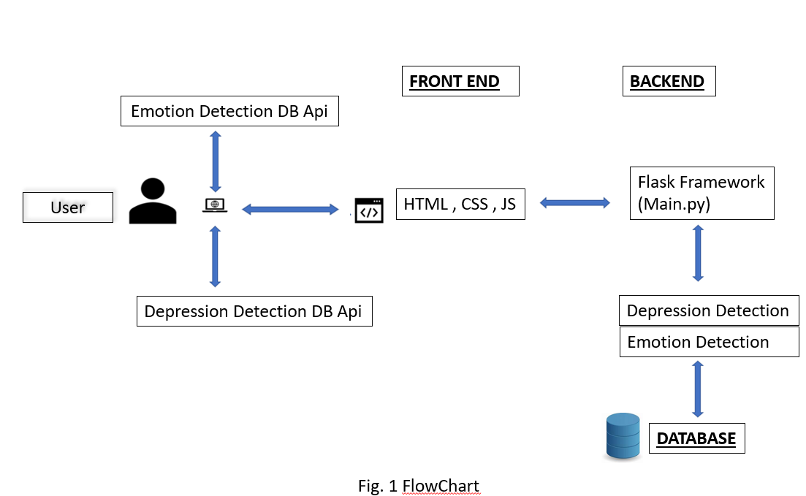
Plan of Action

Slide 7
Literature Survey
Sr no. | Title Of the Paper | Author | Major Observations/Findings
1 | Depression detection using emotional artificial intelligence and machine learning:A closer review(2022) | Manju Lata Joshi a, Nehal Kanoongo b | This study analyses how facial expressions, images,emotional chat_x0002_bots and texts on social media platforms can effectively detect one’s emotions and then depression. Naïve-Bayes,support vector machines,Long term short memory-Radial neural networks,logistic regression,linear support vector are various ML techniques used to recognize emotions from text processing. Artificial neural network is used for feature extraction. Classification of images to detect emotions through facial expressions.
2 | Deep Learning for depression detection from Textual Data(2022) | Amma Amanat 1,Muhammad Rizwan 1,*,Abdul Rehman Javed 2,Maha Abdelhaq 3,Raed Alsaqpour, Sharmil Pandya ,Mueen Uddin | Productive model by implementing long short term memory model, consisting of two hidden layers.Large bias with Recurrent Neural Network with two dense layers. Train RNN on textual data to identify depression from text, semantics, written content.
3 | Machine Learning Algorithms for Depression : Diagnosis, Insights and Research Directions(2022) | Shumaila Aleem, Noor ul Huda, Rashid Amin,*,Samina Khalid, Sultan S. Alshamrani, Abdullah Alshchri | General model diag_x0002_nosis involving data extraction, pre-processing, training ML classifier, detection classification, performance evaluation. Identify Objectives, limitations of different research studies presented in the domain.
4 | Depression Detection using Machine learning techniques(2021) | Kuhaneswaran A/I,Govindasamy,Naveen Palanichamy | Twitter data is fed into different type of classifier i.e. Naive Bayes and Hybrid model,NBTree.

Slide 8

Conclusion & Future Scope
Our project combines CNN for emotion detection and SVM for depression assessment, ensuring precision and accessibility. The user-friendly deployment reflects our commitment to reliable mental health support.
Future Directions:
Wearables & Data
Mobile App Expansion
Telehealth Integration
Innovation Commitment

Slide 9
Thank You !

